Slide 1





Embracing Limited and Imperfect Data: A Review on Plant Stress Recognition Using Deep Learning
2023 ASABE lightning talk
Presented by Mingle Xu
Core Research Institute of Intelligent Robots
Jeonbuk National University, South Korea
Author: Mingle Xu 1, Hyongsuk Kim, Jucheng Yang 2, Alvaro Fuentes, Yao Meng, Sook Yoon, Taehyun Kim, Dong Sun Park

Slide 2
Content
A brief history of plant stress recognition using deep learning
Challenge: a good training dataset is often required but its collecting is not easy.
Limited data
Reasons: model and task
Class-level: few-shot and class imbalance
Dataset-level: domain shift and unknown class
Imperfect data
Basic information: desired annotation strategy EEP
Incomplete annotation
Inexact annotation
Inaccurate annotation
Concluding remarks

Slide 3
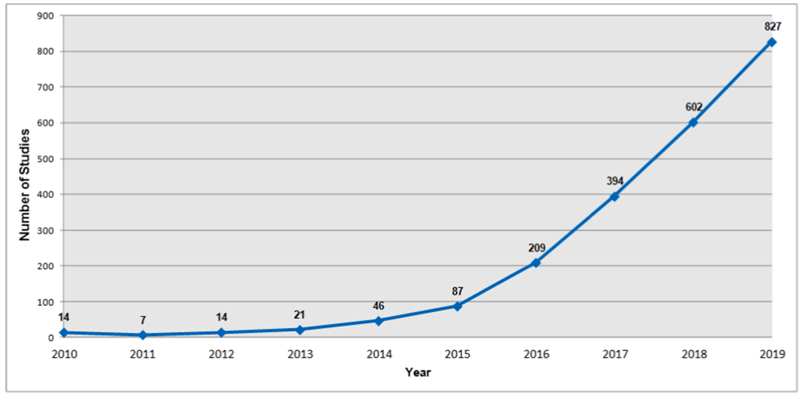
A quick history
The number of publications related to plant stress recognition using deep learning is increasing.
"Plant diseases recognition on images using convolutional neural networks: A systematic review." Computers and Electronics in Agriculture 185 (2021).

Slide 4
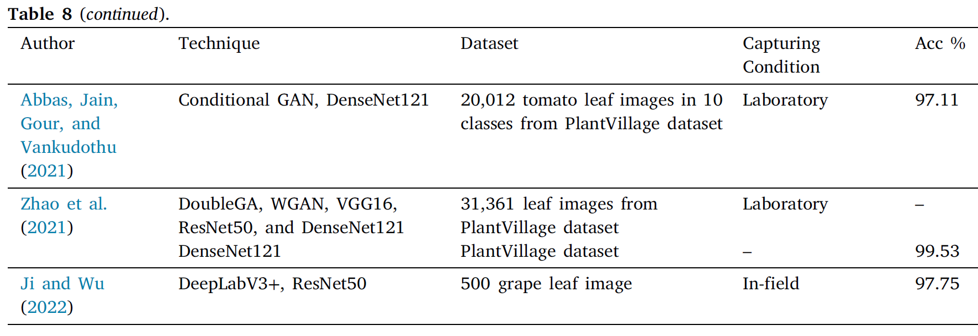
A quick history
The performance is decent in most of the publications.
“Trends in vision-based machine learning techniques for plant disease identification: A systematic review.” Expert Systems with Applications (2022).

Slide 5
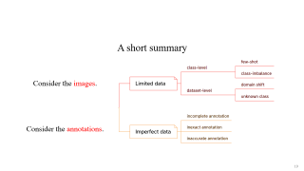
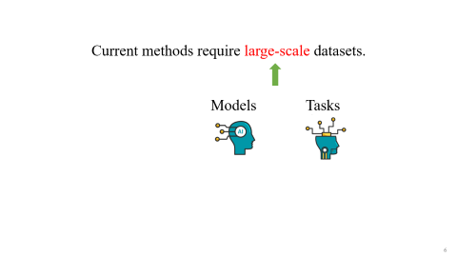
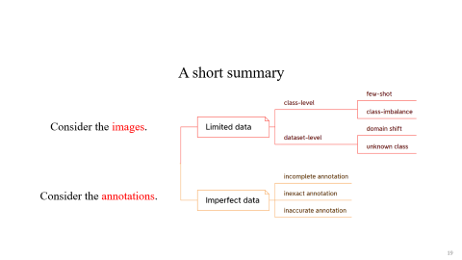

However, current deep learning-based models may suffer in real-world applications.
Because a good training dataset is often required but its collecting is difficult and expensive, and even impractical.
Large-scale dataset.
Annotated properly.

Slide 6


Current methods require large-scale datasets.
Models
Tasks

Slide 7
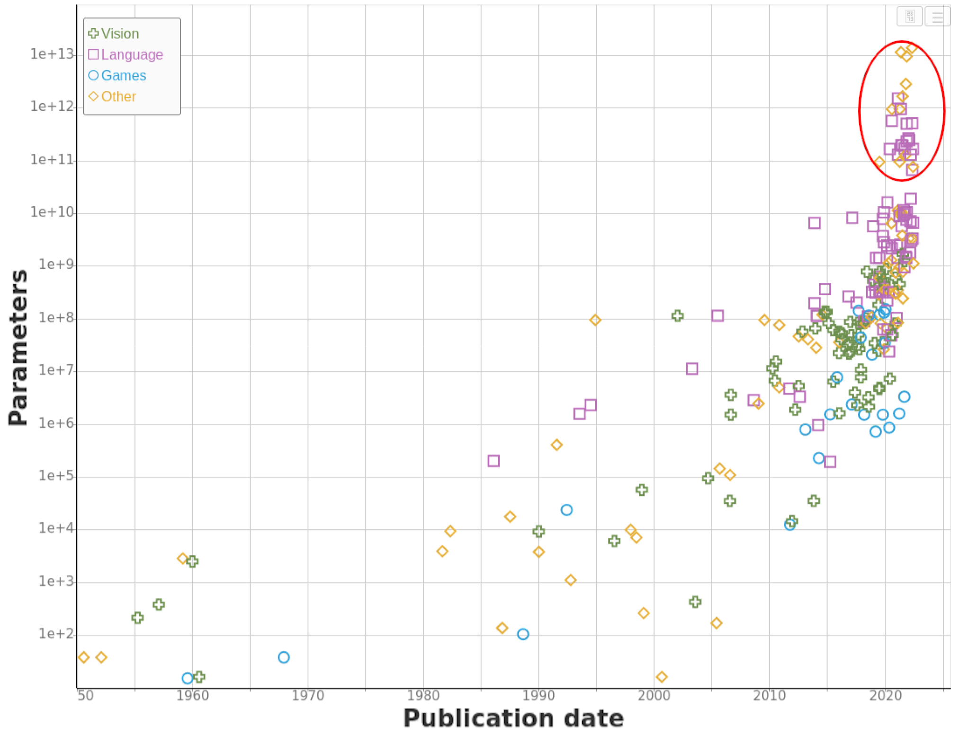
Models
Bigger models tend to have more data to be trained well, otherwise may be overfitting.
"Machine Learning Model Sizes and the Parameter Gap." arXiv (2022).

Slide 8
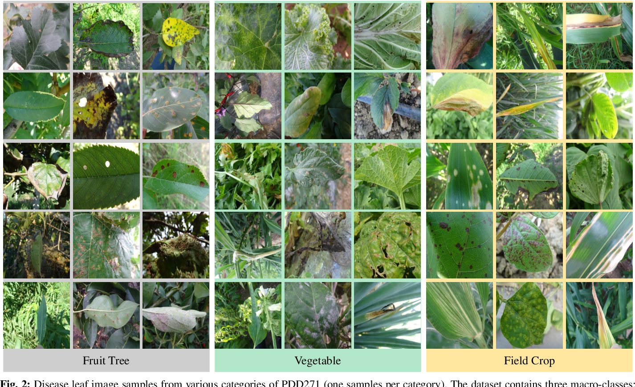
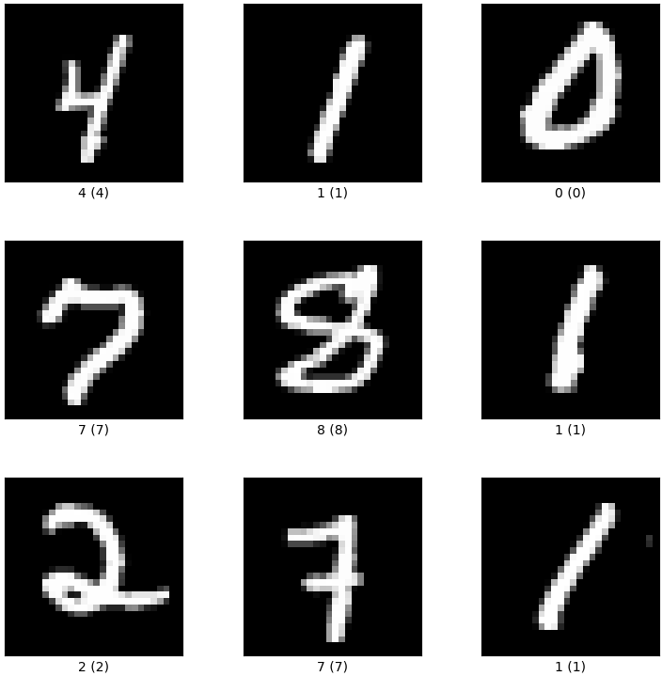
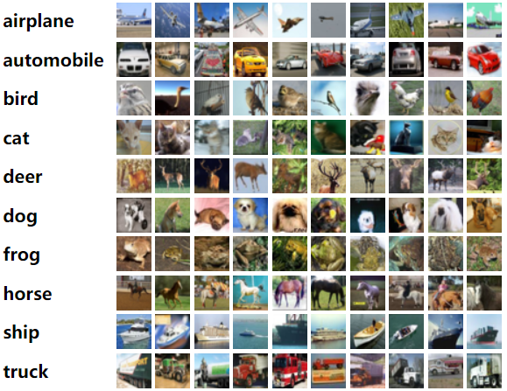
Task: Plant Stress Recognition
Plant stress recognition in real-world applications is complex.
MNIST
CIFAR10
Plant stress images from PDD271
"Gradient-based learning applied to document recognition." Proceedings of the IEEE 86.11 (1998)
"Learning multiple layers of features from tiny images." (2009)
“Plant disease recognition: A large-scale benchmark dataset and a visual region and loss reweighting approach”, TIP 2021.

Slide 9
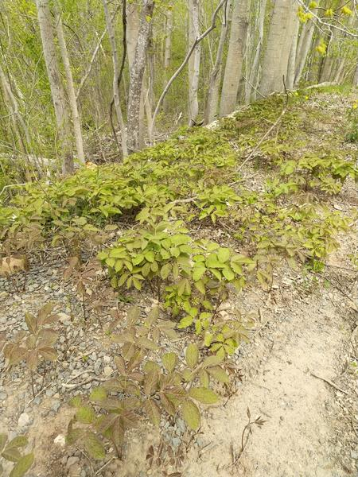
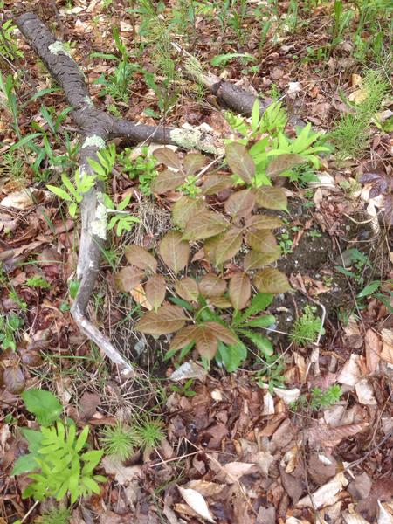
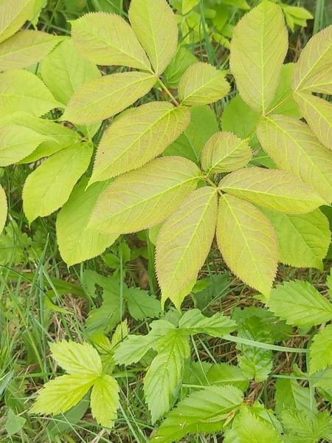
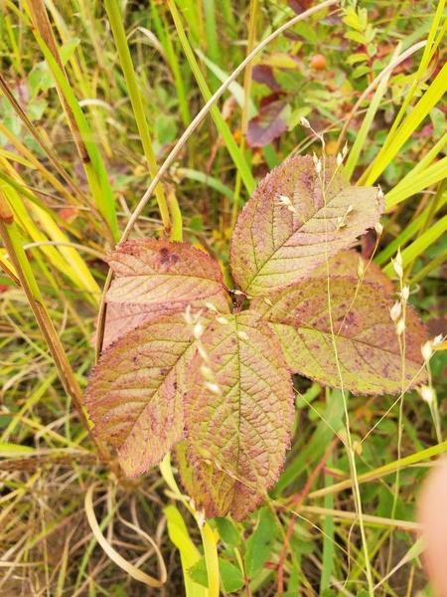
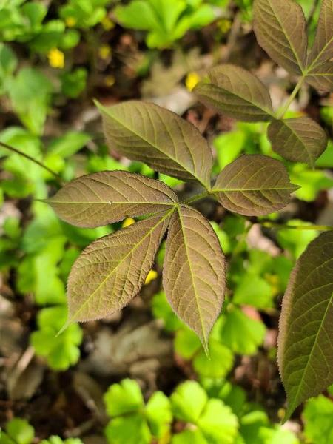
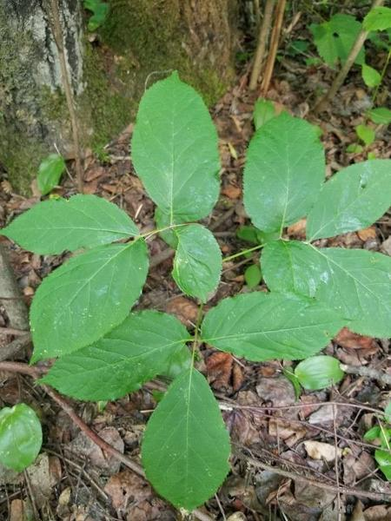
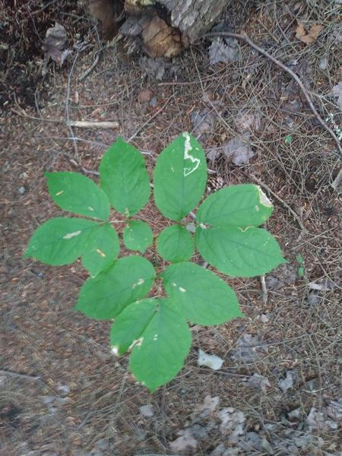
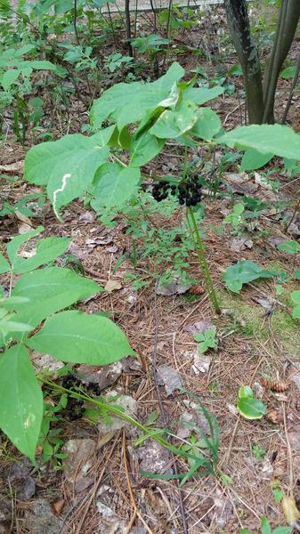
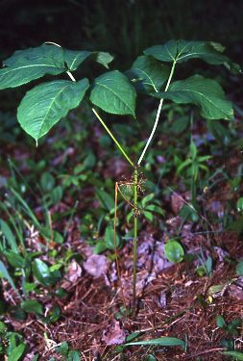
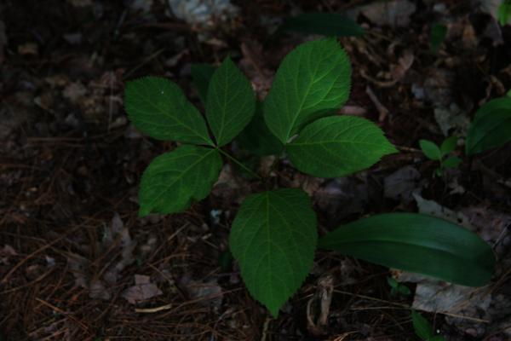
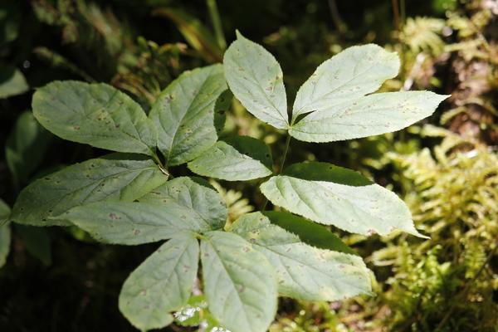
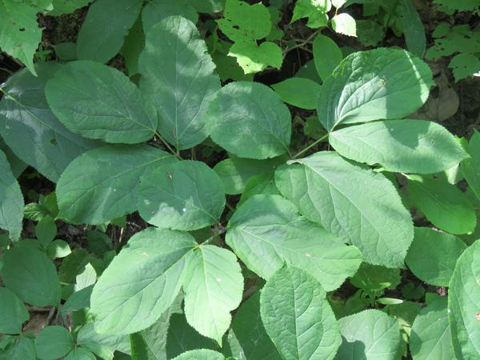
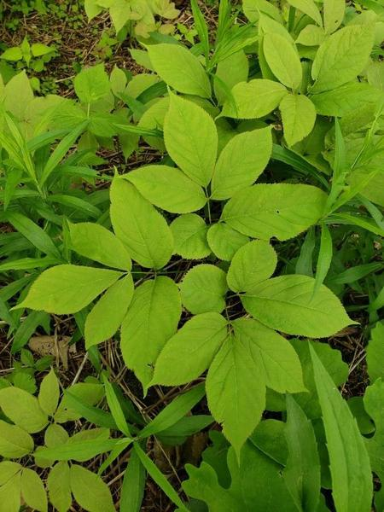
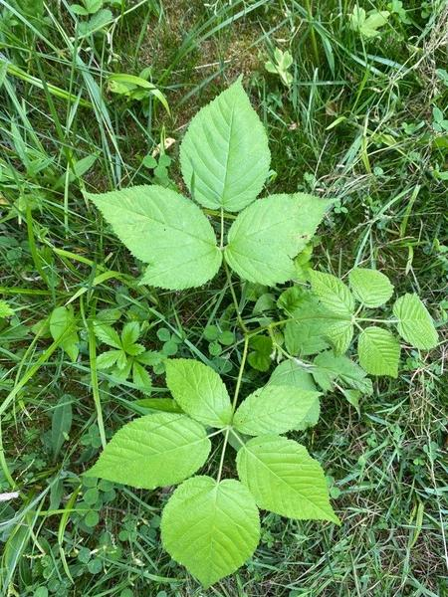
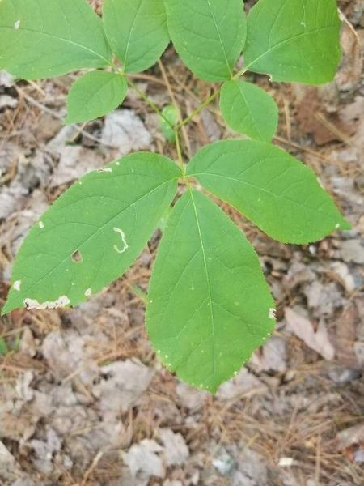
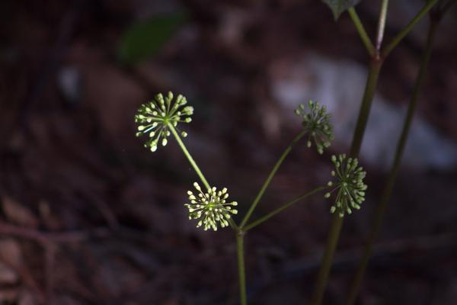
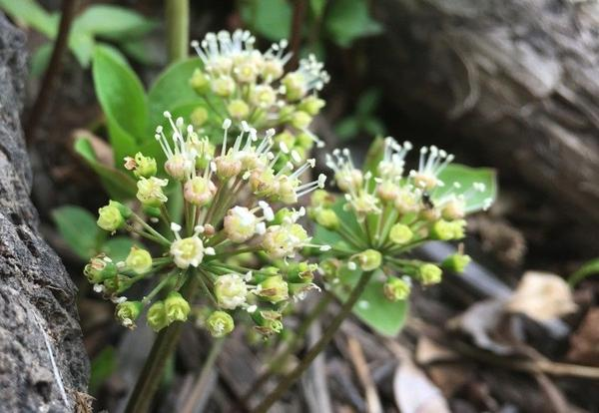
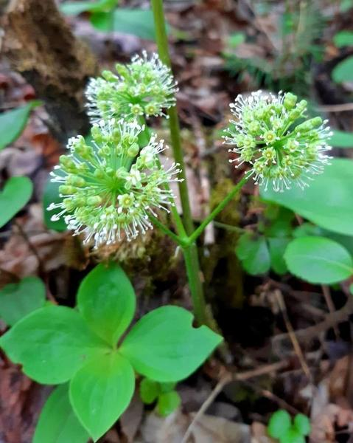
Task: Plant Stress Recognition
Images in plant stress recognition include huge intra-class variations and similar inter-class variations. → need more data to train models with decent performance.
A good dataset should cover these intra-class variations.
Multiscale
Color
Viewpoint
Illumination
Background
Growth stage
Images from the same class (PlantCLEF2022)

Slide 10
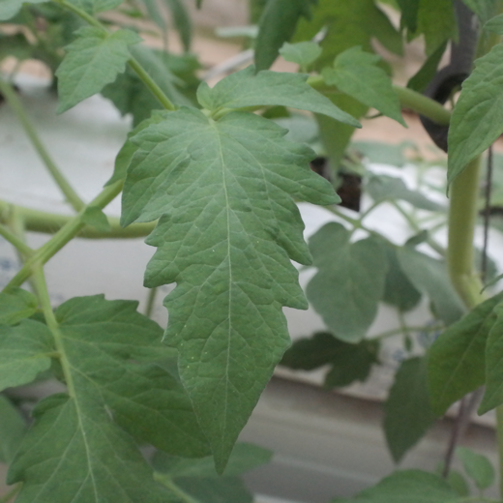
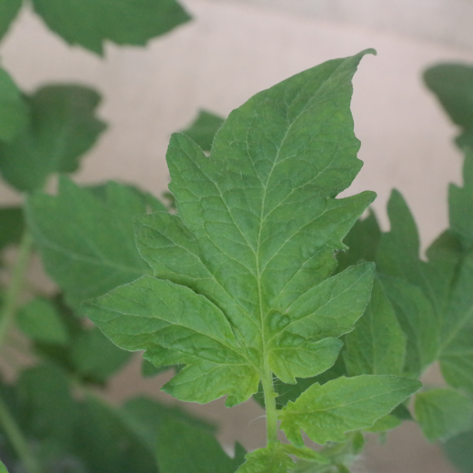
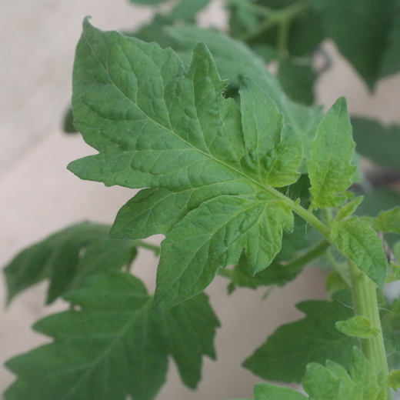
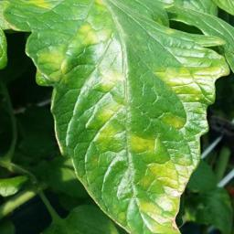
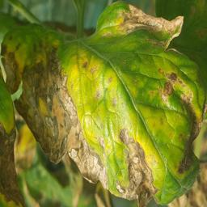
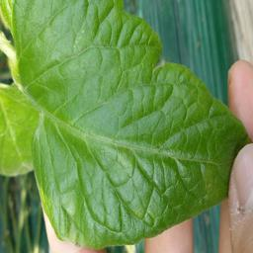
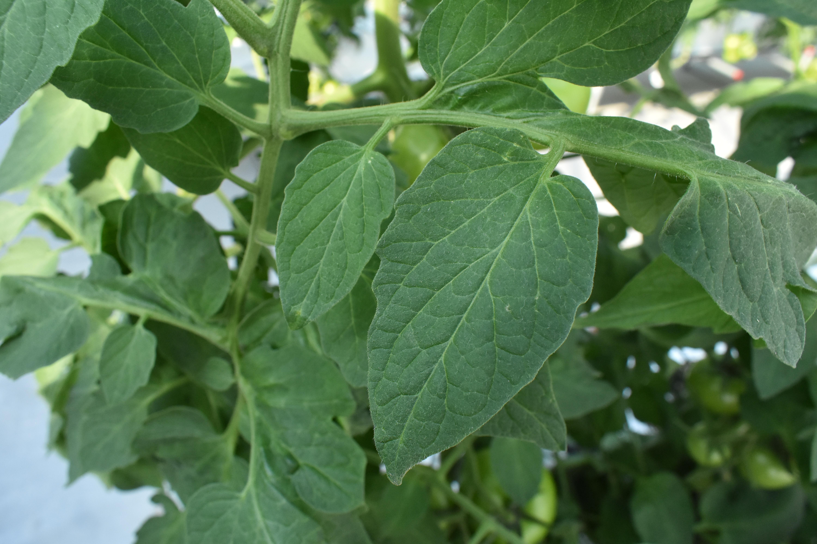
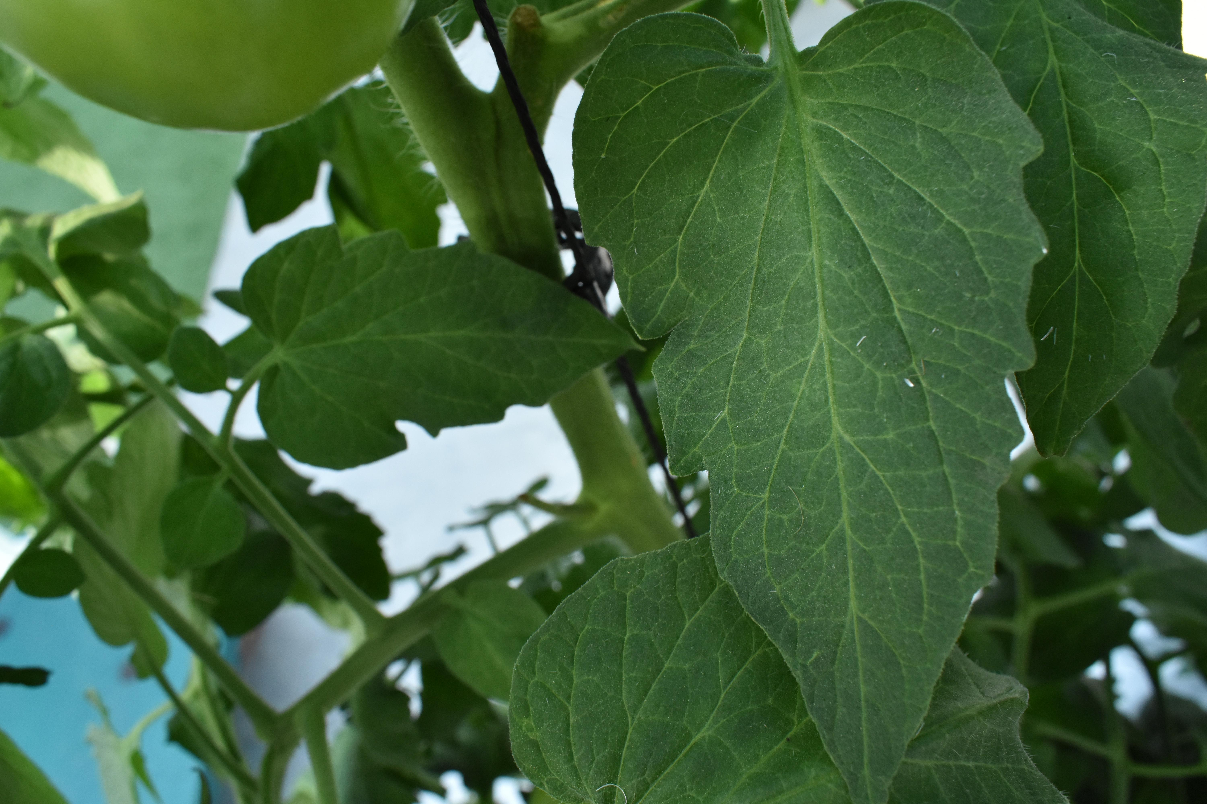
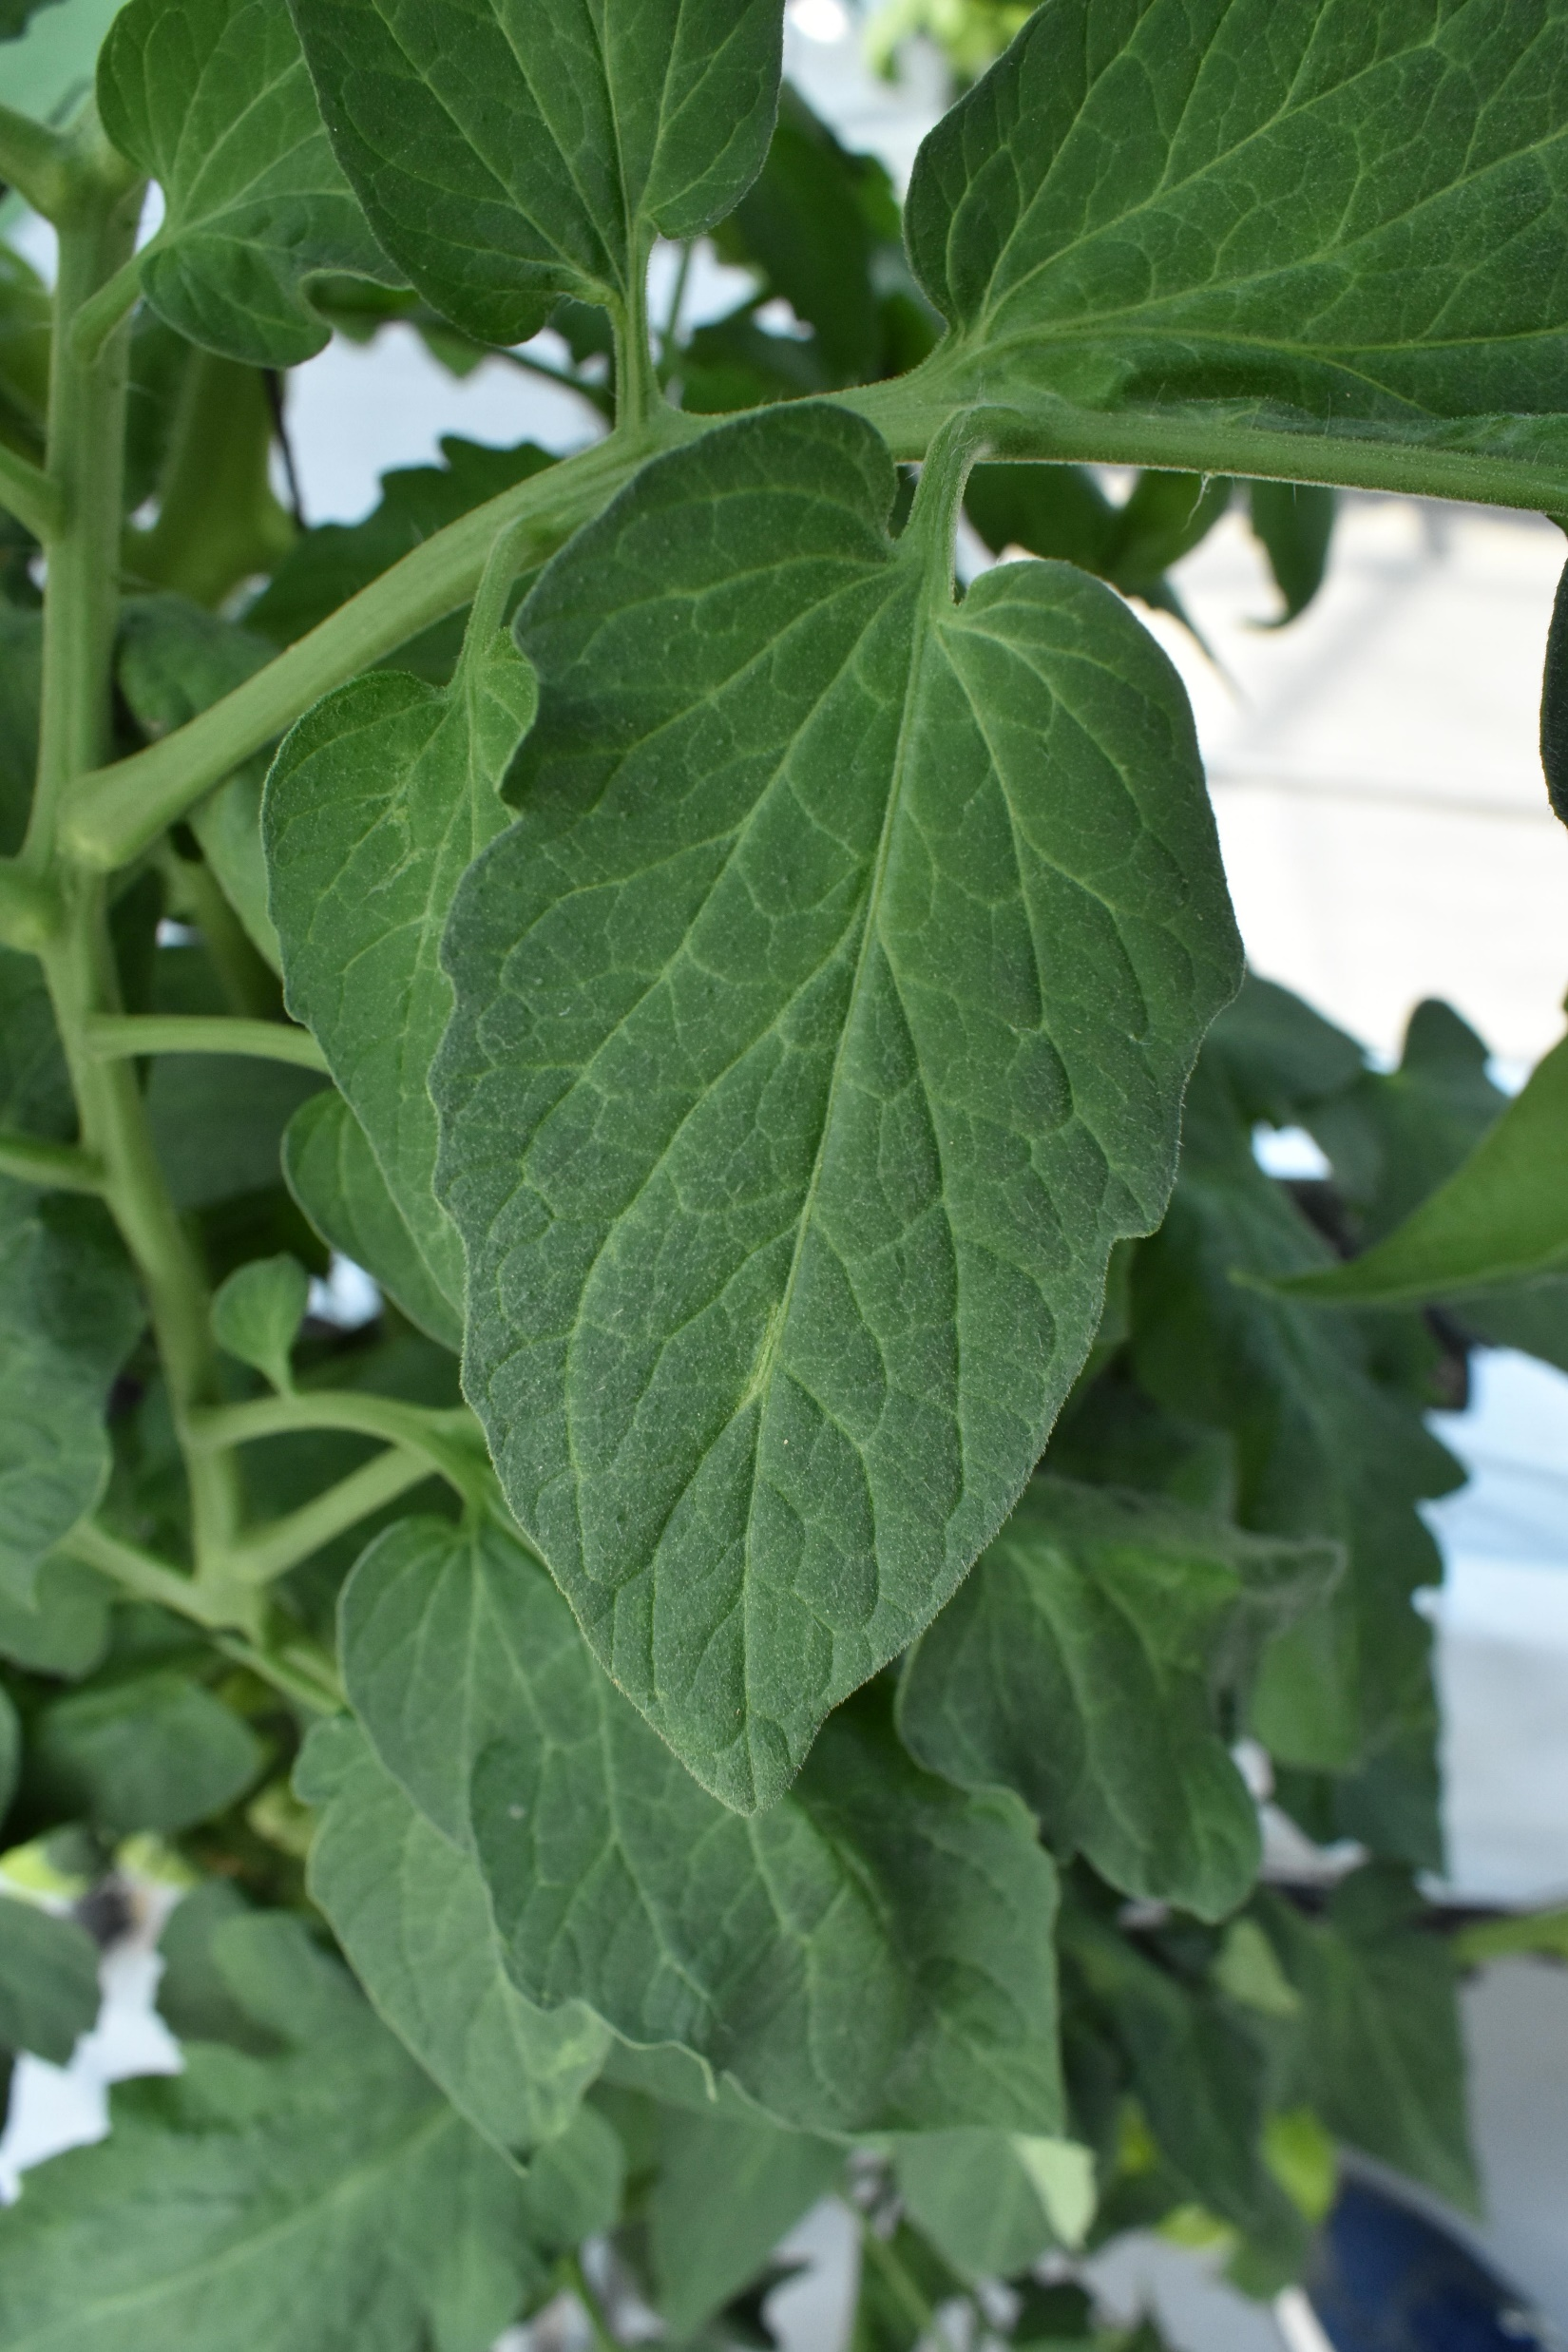
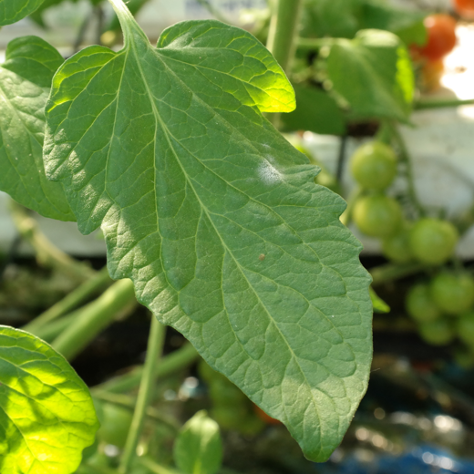
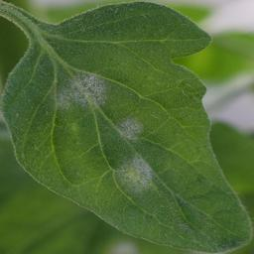
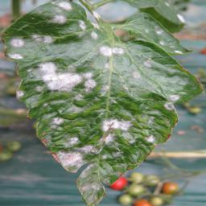
More examples of intra-class variation.
Different types of tomato leaves
Different stages of tomato stress

Slide 11
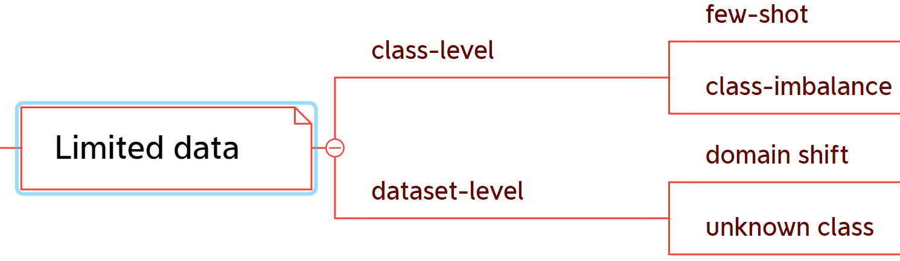
If our training dataset is not in large-scale, …

Slide 12
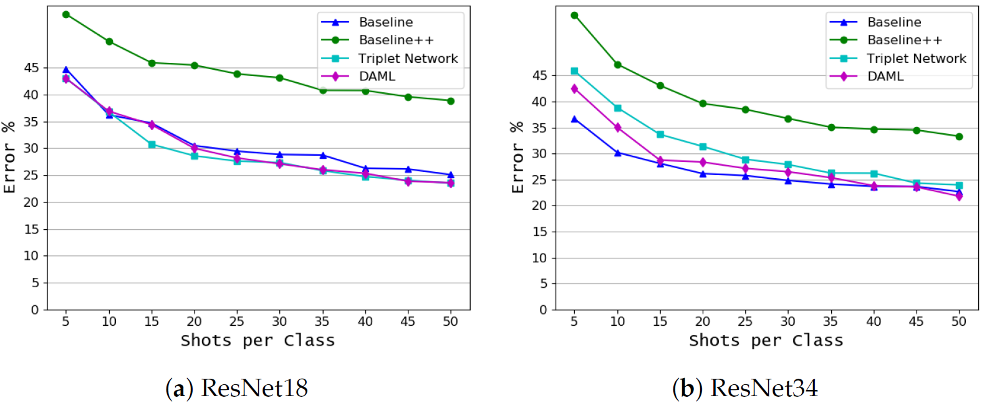
Few-shot
Every class has the same number and few images, such as 10, 20, and 100.
In this scenario, holistic performance is not good, either for every class.
Experiment in PlantVillage.
"Convolutional neural network for automatic identification of plant diseases with limited data." Plants (2020).

Slide 13
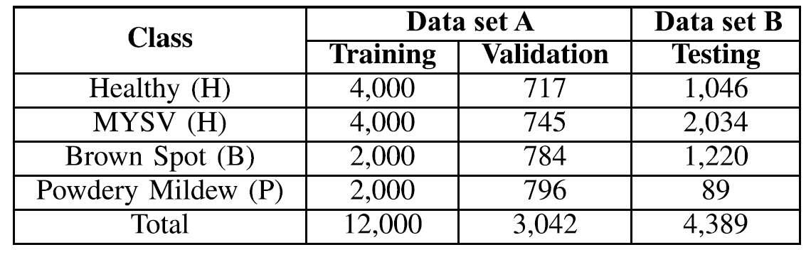
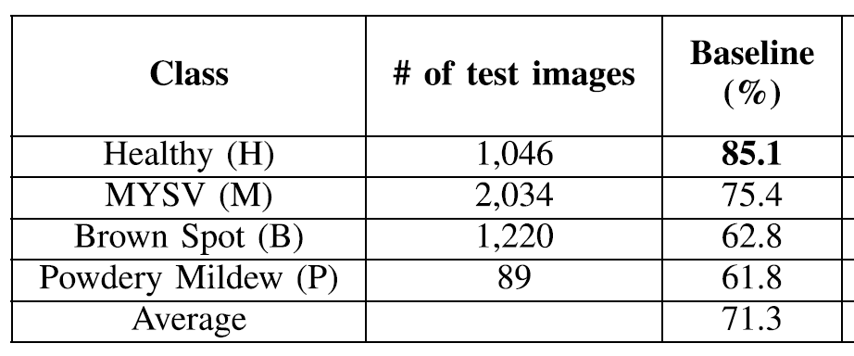
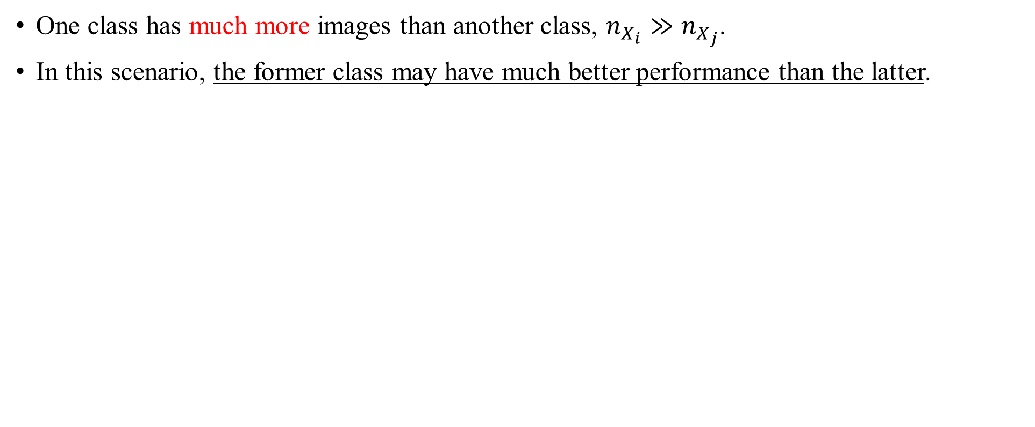
Class imbalance
One class has much more images than another class, $n_{X_{i}}≫n_{X_{j}}$.
In this scenario, the former class may have much better performance than the latter.
"Leafgan: An effective data augmentation method for practical plant disease diagnosis." IEEE Transactions on Automation Science and Engineering (2020).

Slide 14
A short summary
Consider the situation within the training datasets.
Consider the difference between the test and training datasets.

Slide 15
A basic assumption of deep learning
The training and test datasets are in same or similar distribution: $P_{train}≈P_{test}$.
A widely adopted strategy to evaluate models.
The assumption is strong. Scenarios in real-world applications.
Collecting data
Collecting data
Collecting data
Collecting data
Split data
Split data
Training
Validation
Test
Training
Validation
Test
Test
Test
The split almost guarantees they are in a similar distribution.
Spatial and temporary changing
If you can collect a dataset large enough, no problem.

Slide 16
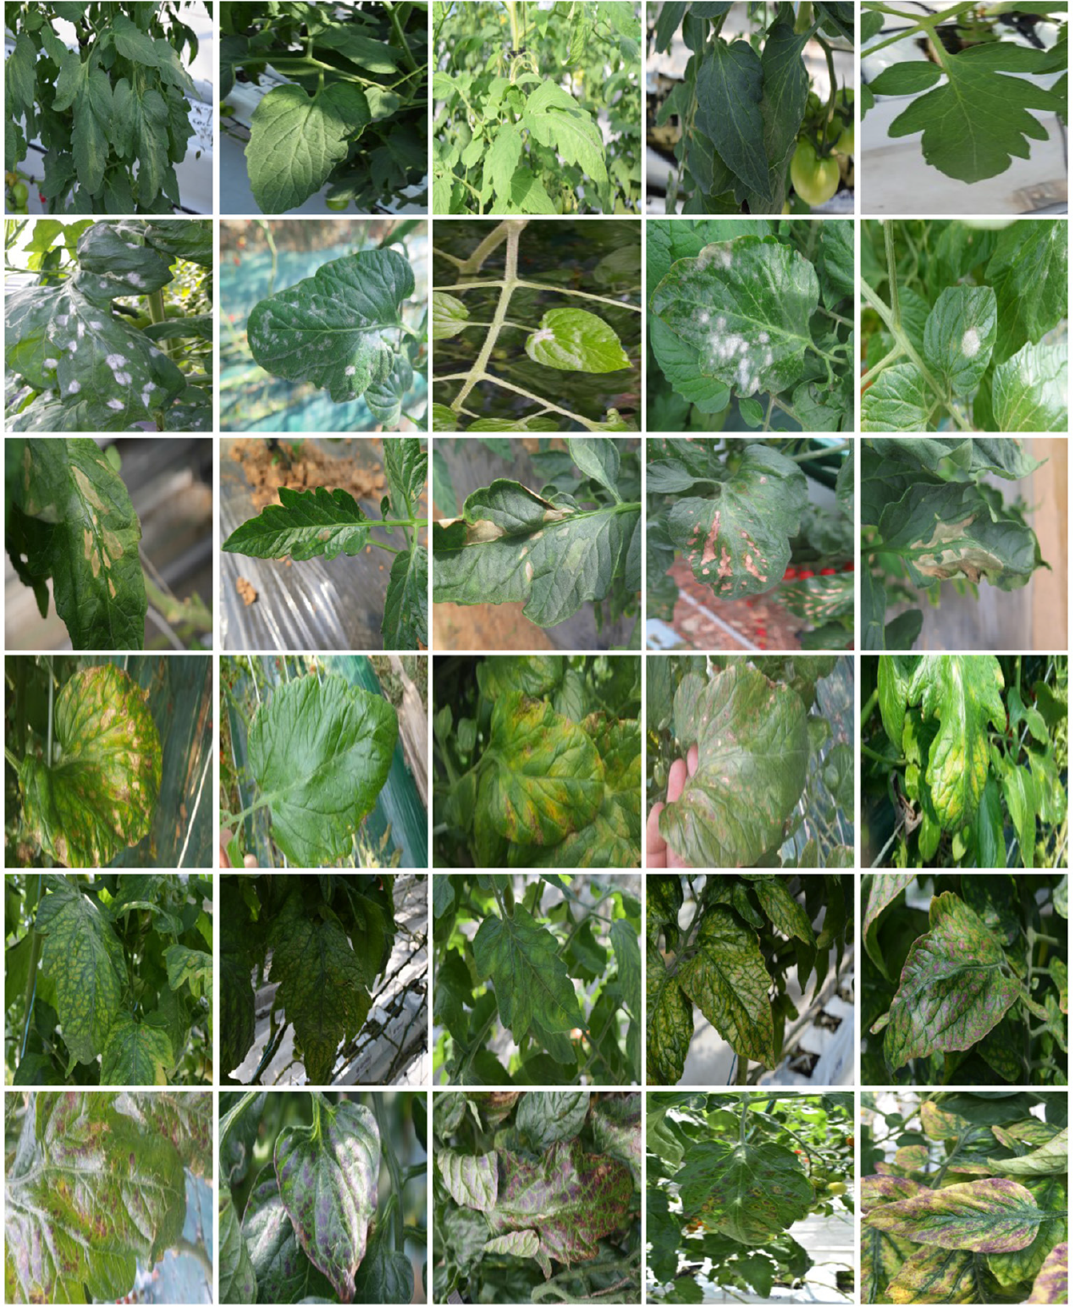
Dataset-level: unknown class
What will happen if we can not collect a large-scale dataset to train models?
Unknown classes may happen in test process.
A new class in the test dataset.

Slide 17
Dataset-level: unknown class
Unknown class challenge: most of the current models just assign an image from a new class as a known class existing in the training dataset.
But the new class may result in big trouble.
An image
Rejecter
Unknown class
Known class
Use the trained classifier
Assign a known class
What is desired? Open set recognition (OSR).
“Known and Unknown Class Recognition on Plant Species and Diseases”, submitted (2023).

Slide 18
Dataset-level: domain shift
Domain shift: the test and training datasets are in different distributions (variations).
Challenge: low performance to recognize those images from the different distributions.
Illumination
Background
Multiscale
Growth stage

Slide 19
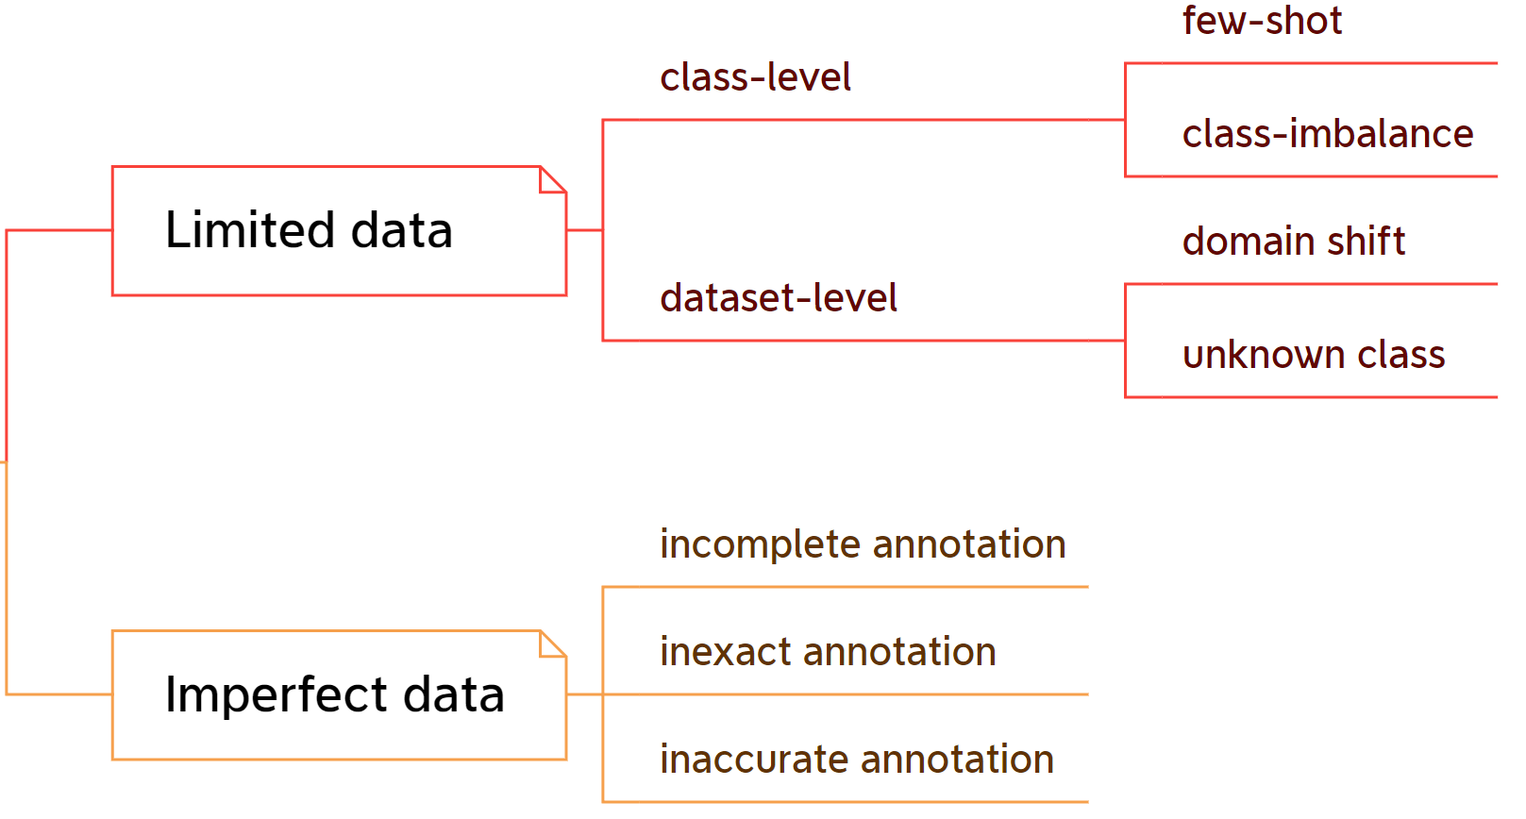
A short summary
Consider the images.
Consider the annotations.

Slide 20
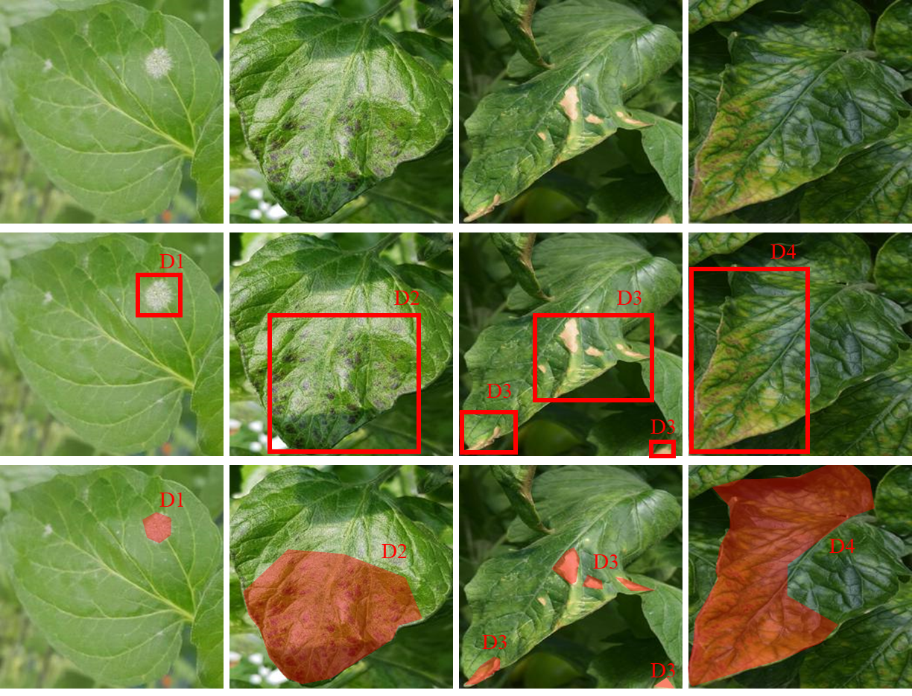
Annotation and its strategies
Different computer vision objectives have different annotations.
Image classification
Assume that one image only covers one class and every image should be annotated with one label.
Object detection
Allow that an image has multi-class and every class is annotated with a pair of label and bounding box.
Segmentation
Every pixel should be annotated with labels.

Slide 21
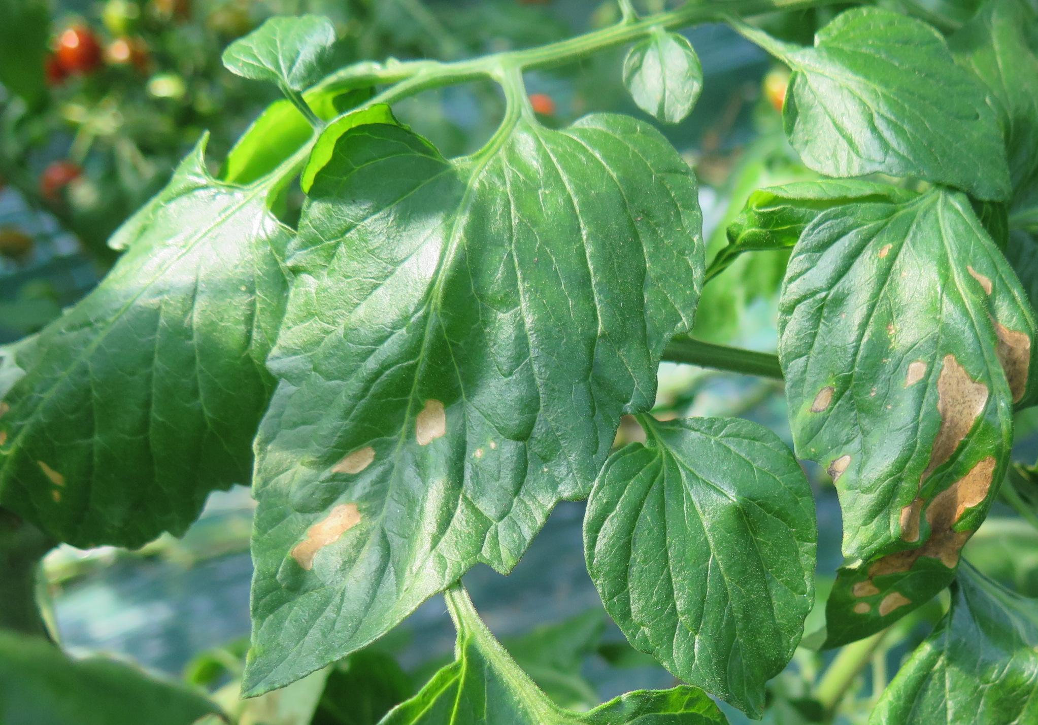
Desired annotation strategy: EEP
Exclusive: one annotation has only one class.
Extensive: every class in one image should be annotated.
Precise: annotations should be precise.
Image classification
Labeled as canker?
But it also has healthy leaves.

Slide 22
Desired annotation strategy: EEP
Exclusive: one annotation has only one class.
Extensive: every class in one image should be annotated.
Precise: annotations should be precise.
Object detection
Just annotate one canker?
But it also has one more.

Slide 23
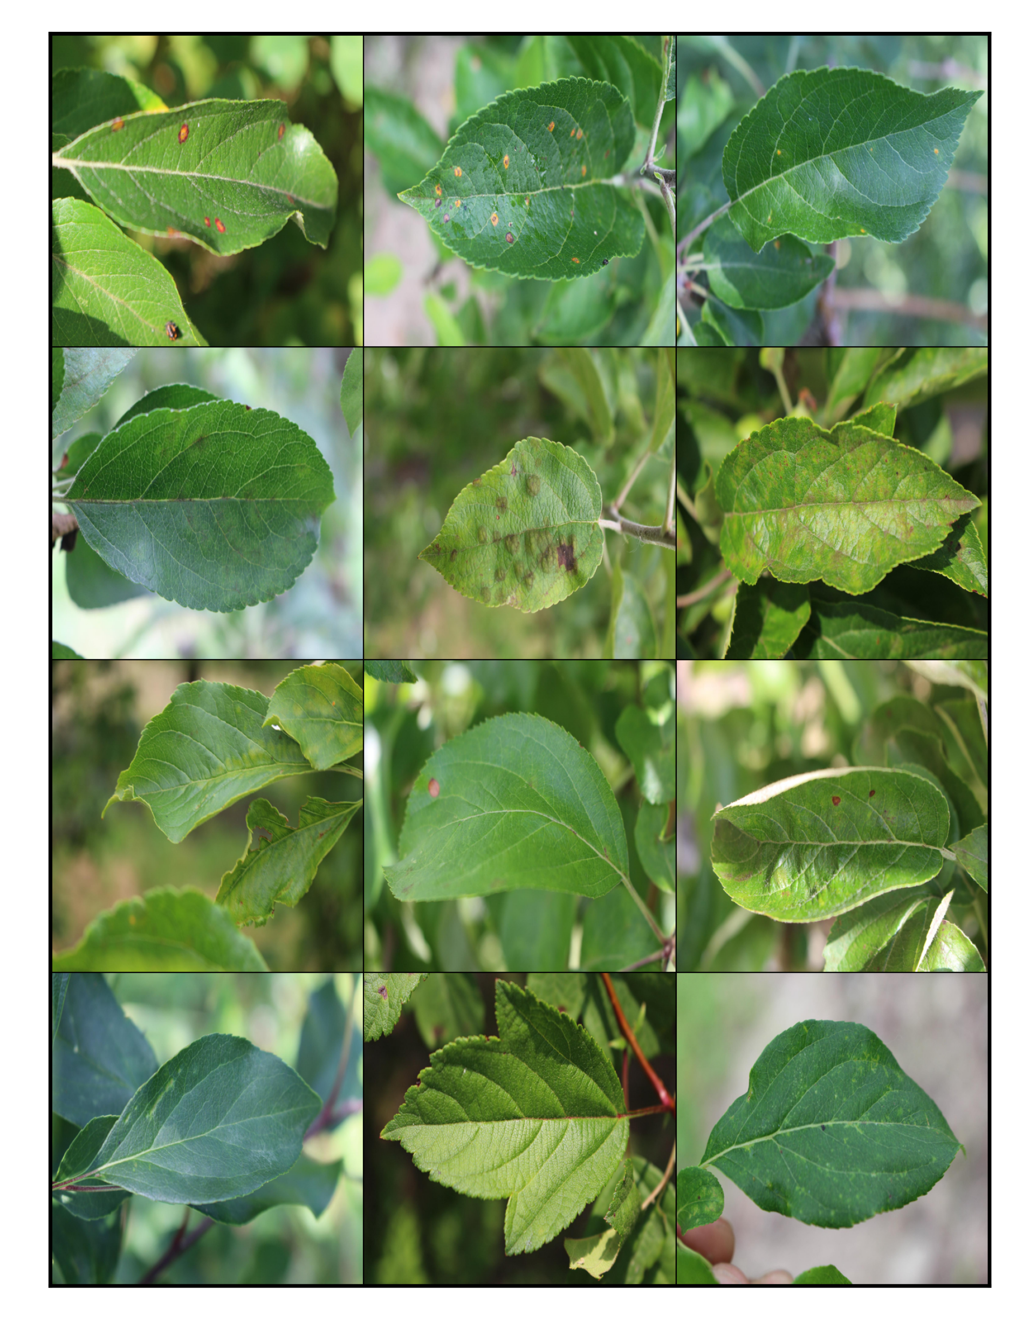
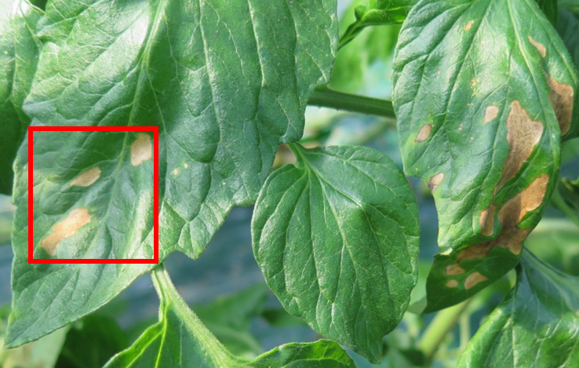
Violation towards the EEP annotation strategy
Incomplete annotation: some images or symptoms are not annotated.
Unlabeled images are much cheaper and may be useful.
Challenge: how to use the unannotated images or symptoms.
Classification
Object detection
Labeled
Unlabeled
Labeled
Unlabeled

Slide 24
Desired annotation strategy: EEP
Exclusive: one annotation has only one class.
Extensive: every class in one image should be annotated.
Precise: annotations should be precise.
Object detection
The bounding box is not precise → bounding box is imprecise.
Annotate it as Powdery Mildew →label is imprecise, actually wrong.
Inaccurate annotation: annotations are not always correct, such as wrong labels, and not precise bounding boxes.

Slide 25

Violation towards the EEP annotation strategy
"Data-centric annotation analysis for plant disease detection: Strategy, consistency, and performance." Frontiers in Plant Science 13 (2022).

Slide 26

Violation towards the EEP annotation strategy
The mixed impact.
"Data-centric annotation analysis for plant disease detection: Strategy, consistency, and performance." Frontiers in Plant Science 13 (2022).

Slide 27
Conclusion
Current deep learning models may suffer in real-world because collecting a desired dataset is difficult, expensive, and even impractical. Embracing limited and imperfect data is a way to address the challenge.
Some mechanisms are proposed to address the challenges but not enough, referring to our preprint paper.
Xu, Mingle, et al. "Embracing Limited and Imperfect Data: A Review on Plant Stress Recognition Using Deep Learning." arXiv (2023).

Slide 28
Concluding remark
Process for a real-world project.
Analyzing datasets is essential for practical applications.
Multiple issues may exist simultaneously and are more difficult.
Recognize the challenges.
Analyze dataset
Rethink the challenges.
Use related mechanisms if available
Execute experiments
Evaluate performance
Xu, Mingle, et al. "Embracing Limited and Imperfect Data: A Review on Plant Stress Recognition Using Deep Learning." arXiv (2023).

Slide 29
Concluding remark
Sometimes we need to rethink our objective and dataset.
High-quality datasets are essential for the community.
Set an objective in a systematic perspective.
Evaluate the objective.
Dataset
Design strategies to collect and annotate data.
Collect data.
Annotate data.
Analyze the challenges in the annotated dataset.
Rethink the dataset.
One disease may be very similar to another one where models can not classify them.
Algorithm
Design a deep learning-based model.
Design the training strategies.
Train and evaluate the model.
Test the model.
The training dataset is poor and we may need to collect another one.
Xu, Mingle, et al. "Embracing Limited and Imperfect Data: A Review on Plant Stress Recognition Using Deep Learning." arXiv (2023).

Slide 30
Thank You Questions and Comments
Email: xml@jbnu.ac.kr to Mingle Xu
Public slides: https://xml94.github.io/presentations.html
The complete paper is available at https://arxiv.org/abs/2305.11533

Slide 31



Examples of real scenarios.
Images vary in different farms such as the background.
"Open Set Self and Across Domain Adaptation for Tomato Disease Recognition With Deep Learning Techniques." Frontiers in Plant Science (2021)

Slide 32

Desired annotation strategy: EEP
Exclusive: one annotation has only one class.
Extensive: every class in one image should be annotated.
Precise: annotations should be precise.
Image classification
Labeled as powdery mildew?
But it also has ToCV.
Preprocessing: crop.

Slide 33

Incomplete annotation: some images or symptoms are not annotated.
Unlabeled images are much cheaper and may be useful.
Challenge: how to use the annotated images or symptoms.
Classification
Object detection
Labeled
Unlabeled
Labeled
Unlabeled
Introduction to Semi-Supervised Learning, ICML tutorial 2007.

Slide 34
When the EEP annotation strategy is violated, imperfect data appear.

